Slide 1












Car Price Prediction
using Machine Learning
Leveraging historical data and advanced algorithms to accurately estimate used car values
Random Forest Regressor

Slide 2
















Project Overview
A regression-based machine learning project aimed at predicting the selling prices of used cars by analyzing CarDekho listings. The model helps car dealers and buyers make data-driven decisions.
Dataset
Tools
Approach
Comprehensive collection of used car listings from CarDekho
Python, Pandas, NumPy, Matplotlib, Seaborn, Scikit-learn
Regression modeling to establish relationships between car features and selling price
Data-driven pricing
Competitive pricing
Market efficiency
Page 2 of 14

Slide 3



















Problem Statement & Objectives
The Problem
Manually estimating car prices is inefficient and prone to inaccuracies due to the multitude of influencing factors:
Age of the vehicle
Mileage driven
Fuel type
The Objective
Build a robust machine learning model capable of predicting used car selling prices based on their features.
Accurate price estimation
Data-driven decisions
Benefit car dealers and buyers
Page 3 of 14

Slide 4



















Dataset Features & Structure
The CarDekho used car listings dataset includes eight key features that influence car pricing:
Car Name
Year
Selling Price
Km Driven
Brand and model of the car
Manufacturing year
Target variable (₹)
Distance driven
Fuel
Seller Type
Transmission
Owner
Type of fuel (Petrol, Diesel, etc.)
Dealer / Individual
Manual / Automatic
First/Second/Third owner
These features capture the essential characteristics that influence used car pricing in the market.
Page 4 of 14

Slide 5





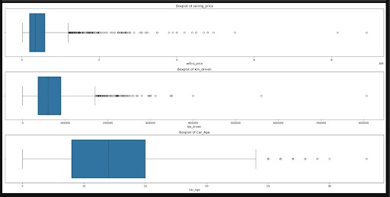

Exploratory Data Analysis (EDA)
Initial exploration of the CarDekho dataset to uncover patterns, detect anomalies, and understand key characteristics.
Data Quality Checks
Feature Analysis
Verified integrity for missing values
Analyzed distributions of key variables
Identified duplicate entries
Detected patterns in selling prices
Key Visualizations
Key Findings
Insights:
Selling Price: Shows multiple outliers, indicating the presence of premium/high-end vehicles.
Kilometers Driven: Highly skewed with outliers, showing that while most cars have lower mileage, a few are driven extensively.
Car Age: Majority of cars are between 5–15 years old, with a few much older vehicles.
Conclusion: Outliers exist across all numerical variables and may need to be handled during model building to improve prediction accuracy.
Page 5 of 14

Slide 6
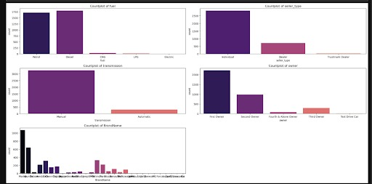
Exploratory Data Analysis (EDA)
Initial exploration of the CarDekho dataset to uncover patterns, detect anomalies, and understand key characteristics.
Key Findings
Insights:
Fuel Type: Petrol and Diesel dominate the dataset, with very few CNG, LPG, or Electric vehicles.
Seller Type: Most listings are from individual sellers, followed by dealers.
Transmission Type: Manual transmission cars are far more common than automatic ones.
Owner Type: Majority are first-owner vehicles, while second, third, and test-drive cars form a smaller portion.
Brand Distribution: A few brands have a high number of listings, while most others appear less frequently.
Conclusion: The dataset mainly consists of manual, petrol, first-owner cars sold by individuals, reflecting typical market composition.
Key Visualizations
Page 5 of 14

Slide 7
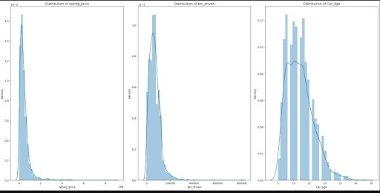
Exploratory Data Analysis (EDA)
Initial exploration of the CarDekho dataset to uncover patterns, detect anomalies, and understand key characteristics.
Key Findings
Insights:
Selling Price: Right-skewed, meaning most cars are low-priced with a few expensive ones.
Kilometers Driven: Right-skewed, suggesting most cars have low to moderate usage.
Car Age: Approximates a normal-like distribution, centered around mid-aged cars (5–10 years).
Conclusion: The data distributions indicate non-normality in price and usage, which should be addressed through transformations or scaling before modeling.
Key Visualizations
Page 5 of 14

Slide 8
















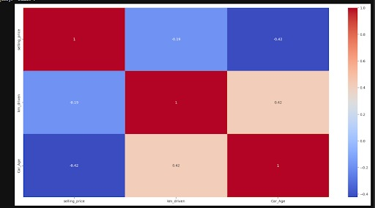







Key Data Insights
Positive Correlation
Fuel Type Influence
Newer cars generally command higher selling prices, showing a positive correlation between car year and selling price.
The type of fuel significantly impacts a car's value.
Petrol models
Diesel models
Other fuel types
Year
Selling Price
Transmission Impact
Transmission type (manual vs. automatic) significantly affects car values.
Manual transmission
Automatic transmission
Key Finding: High-end models identified as outliers; categorical data encoded for ML compatibility.
Page 6 of 14

Slide 9















Data Preprocessing Steps
Raw Data
Encoding
Normalization
Feature Selection
Train-Test Split
1
2
Categorical Data Encoding
Numerical Normalization
Applied LabelEncoder to convert categorical columns into numerical format
Normalized numerical values to ensure balanced influence across features
Encoded 'Fuel', 'Seller Type', 'Transmission', and 'Owner' columns
Prevented features with larger scales from disproportionately affecting the model
Ensures machine learning models can process non-numerical data
Applied where necessary to maintain model accuracy
3
4
Feature Selection
Train-Test Split
Removed irrelevant or redundant features to reduce noise
Split dataset into 70% training and 30% testing sets
Focus on most impactful car features for price prediction
70% used for model training and validation
Improved model efficiency and reduced overfitting risk
30% reserved for unbiased performance evaluation
Dataset Preparation
100%
Page 7 of 14

Slide 10















Machine Learning Models
Linear Regression
Decision Tree
Random Forest
A fundamental statistical model that establishes a linear relationship between independent features and the target variable (selling price).
A non-linear model that partitions the data into subsets based on feature values, creating a tree-like structure to make predictions.
An ensemble learning method that builds multiple decision trees and combines their predictions to improve accuracy and reduce overfitting.
Captures complex, non-linear relationships
Simple and interpretable model
Intuitive and easy to understand
Reduces overfitting compared to single decision trees
Establishes baseline for comparison
Can overfit the training data
Assumes linear relationship between features and target
High performance in various regression problems
Robust to outliers and noisy data
Good starting point for regression tasks
Partitions feature space into rectangular regions
Often the best choice for complex datasets
Page 8 of 14

Slide 11









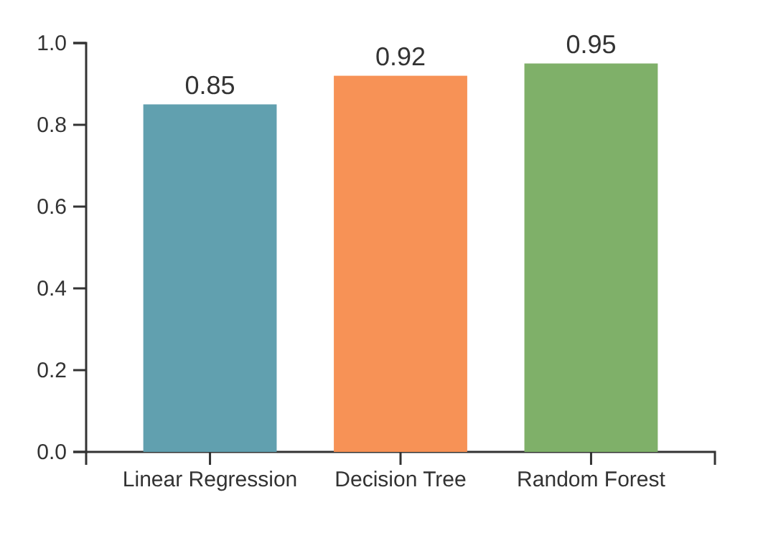



Model Performance Evaluation
Comparing the performance of regression models using standard evaluation metrics:
R² Score
RMSE
MAE
Coefficient of determination. Higher is better.
Mean Absolute Error. Lower is better.
Mean Squared Error. Lower is better.
Model
RMSE
Model
MAE
Linear Regression
361789~
Linear Regression
180845~
Decision Tree
301425~
Decision Tree
150706~
Random Forest
241614~
Random Forest
122313~
Key Findings
Random Forest Regressor achieved the highest R² score (~0.95), indicating superior predictive accuracy
Decision Tree Regressor performed better than Linear Regression across all metrics
Random Forest models typically outperform simpler regression techniques in car price prediction tasks
Page 9 of 14

Slide 12

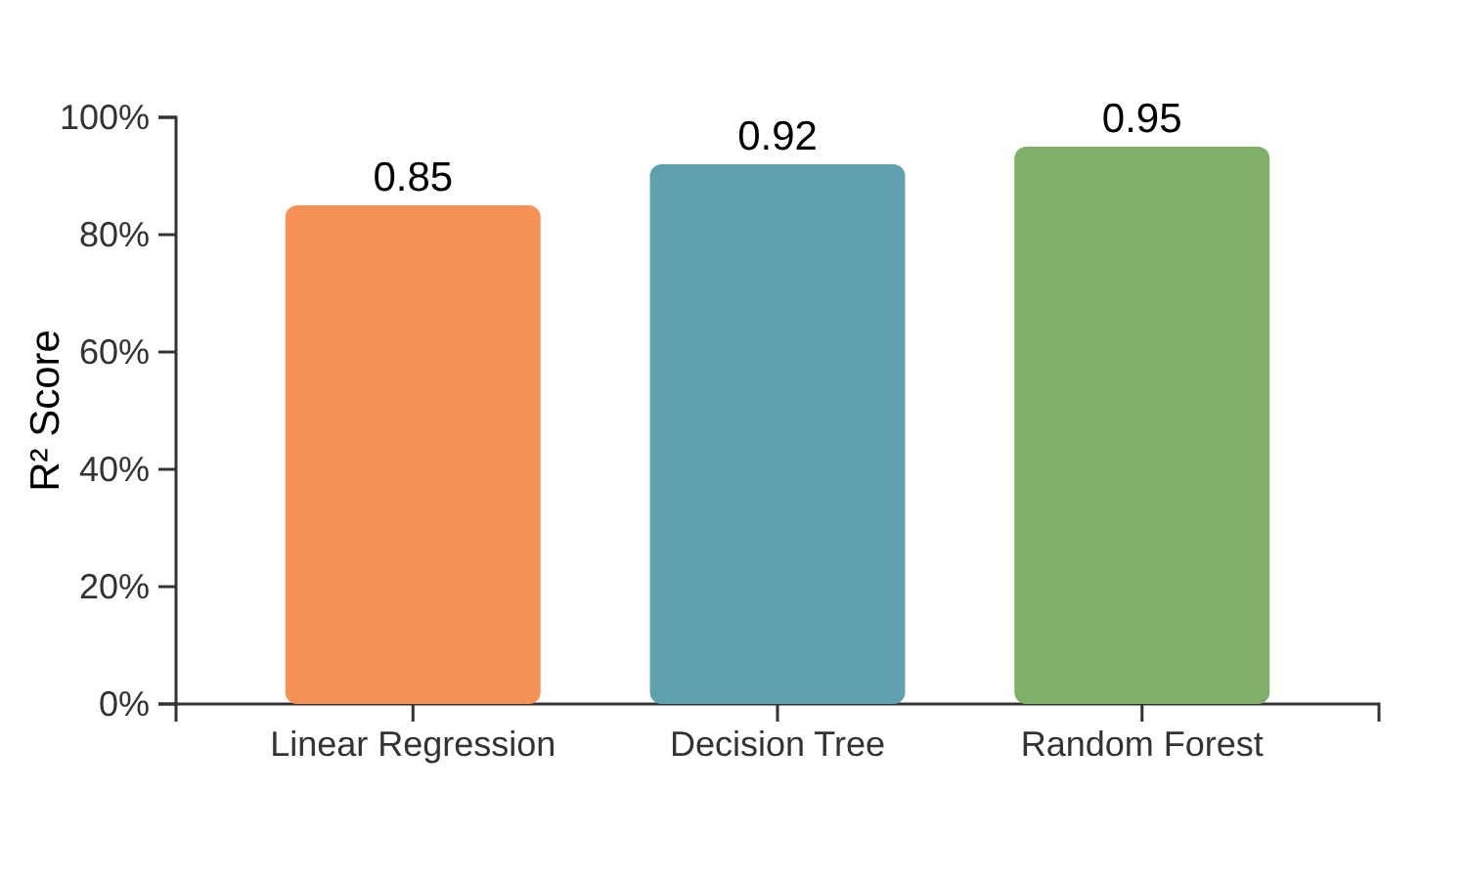











Results & Best Model
The Random Forest Regressor emerged as the best-performing model with an R² score of 0.95, outperforming Linear Regression (~0.85) and Decision Tree (~0.92).
Random Forest
R² score: 0.95
Decision Tree
R² score: 0.92
Linear Regression
R² score: 0.85
Why Random Forest Performed Best
Handles non-linear relationships well
Reduces overfitting through ensemble averaging
Less sensitive to outliers in the data
Properly captures interactions between features
Page 10 of 14

Slide 13





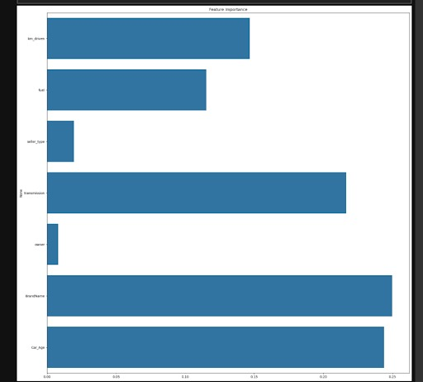




Feature Importance Analysis
Key factors influencing car price prediction:
Car age
Newer cars command higher prices. Strong positive correlation between year and selling price.
Kilometers Driven
Higher mileage typically means lower value. Significant factor in determining car depreciation.
Fuel Type
Different fuels have varying costs and efficiency, impacting the overall value of the vehicle.
Page 11 of 14

Slide 14













Practical Applications
The car price prediction model offers valuable applications for key stakeholders in the automotive market, enhancing efficiency and transparency for all parties involved.
For Market Transparency
For Car Dealers
For Car Buyers
Set competitive prices based on accurate valuations
Make informed purchasing decisions
Standardize pricing across the used car market
Evaluate offered prices against market value
Establish data-driven pricing strategies
Provide objective valuations regardless of seller
Improve inventory management with accurate valuations
Understand factors that influence car values
Enhance trust in the buying and selling process
"The model serves as a valuable tool for car dealers to set competitive prices and for buyers to make informed purchasing decisions, thereby enhancing efficiency and transparency in the used car market."
Page 12 of 14

Slide 15













Future Enhancements
Potential improvements to enhance prediction accuracy and model robustness.
Regional Data Integration
Market Demand Trends
Advanced Modeling
Include regional economic indicators
Integrate current market demand data
Explore advanced ensemble techniques
Account for local market conditions
Capture seasonal and trend-based variations
Implement deep learning models
Implementation Priority
Implementation Priority
Implementation Priority
Granular Vehicle Specifications
Integrate more detailed vehicle specifications for improved accuracy.
Page 13 of 14

Slide 16










Conclusion & Impact
Our project successfully developed a machine learning model for predicting used car prices, with the Random Forest Regressor achieving an impressive R² score of approximately 0.95.
Model Performance
Key Insights
Random Forest Regressor demonstrated superior accuracy with R² score of ~0.95
Year, km driven, and fuel type significantly influence price
Manual transmission commands higher prices
First owner cars retain more value
Impact & Applications
Competitive pricing for dealers
Informed buyer decisions
Market efficiency
"This model offers a data-driven approach to an otherwise complex and often inefficient manual estimation process, enhancing transparency and efficiency in the used car market."
Page 14 of 14

